Slide 1
High School Parent/Student Orientation
Immanuel Christian Secondary School
2022 / 2023

Slide 4
Differences from Grade 8 to 9
Transitions: Bridging the journey from Middle School to High School
80 Minute Classes
Semester System ( 3 “Core” per semester)
Full-Year Math and Language Arts (Alternating Days)
Expanded choices for options
Not a sink-or-swim approach – Homeroom Groupings

Slide 5
Grade 9: Building Capacity
Take ownership of their learning
Developing Positive Habits of Learning → How you show up MATTERS!
Punctuality → In class on time and ready to learn
Positive and Thoughtful Class Contributions → You are NOT a bystander
Organization →Having what you need and when you need it
Committed to Learning → The work I submit is MINE and reflects my best efforts

Slide 6
Grade 9: Building Capacity
Grade 9 IS NOT Grade 8+
Courses are more rigorous and have greater expectations for engagement
Final marks and subject matter competence will have impact on future pathways for programming in Grades 10-12
Utilizing CORE Time
Building connection with teachers – self advocacy
Staying on top of course content and assignments

Slide 7
Differences from Grade 9 to 10
You will start earning credits to earn your high school diploma
The Alberta Government grants the diploma based on their requirements
Courses at the grade 10 level are designated as “10/14/15”
Course at the grade 11 level are designated as “20/24/25”
Courses at the grade 12 level are designated as “30/35“

Slide 8
Differences from Grade 9 to 10
No longer part of a class grouping or homeroom
‘Main Stream’ are -2, -3 level courses
‘Academic Stream’ are -1 level courses
Requires an increased level of desire, commitment, work
Entry in a grade 10 course is based on grade 9 reports/recommendations – ICSS Streaming Policy
You do not advance to the next level unless you pass and get credits in the current course (advancement is course by course)

Slide 9
How do I earn a High School Diploma?
You must earn a minimum of 100 credits
Core classes are 5 credits
Elective classes (“Options”) can be 3, 5 or more credits
English to the 30 level
Social to the 30 level
Mathematics and Science at 20 level (Minimum)
Other electives that you can take to the 30 level

Slide 10
Required Credit Courses @ Immanuel Christian Secondary
Grade 10 | Grade 11 | Grade 12 | Minimum Credits
English 10-1 or English 10-2 | English 20-1 or English 20-2 | English 30-1 or English 30-2 | 15
Social 10-1 or Social 10-2 | Social 20-1 or Social 20-2 | Social 30-1 or Social 30-2 | 15
Math 10C or Math 10-3 | Math 20-1 or Math 20-2 or Math 20-3 |  | 10
Science 10 or Science 14 | Science 20 or Science 24 or Biology 20 or Chemistry 20 or Physics 20 |  | 10
Physical Education 10 |  |  | 3
CALM 20 |  |  | 3
 | Religious Meanings 20 |  | 3
 |  | Sociology 30 | 3
10 credits in Career and Technology Studies (CTS), or Fine Arts or Second Languages, Locally Authorized Courses, or Phys. Ed. 20 and/or Phys. Ed. 30 |  |  | 10
10 credits in any 30 level courses other than English and Social Studies (Students may use Work Experience 35) |  |  | 7
The final 18 credits required can be from any combination of 10, 20 or 30 level courses not already accounted for. Total Credits Required for a Diploma = 100 |  |  | 82
These are the minimum requirements to earn your high school diploma. If you have goals specific to a profession, or attending college or university, we will help you look at other requirements.

Slide 11
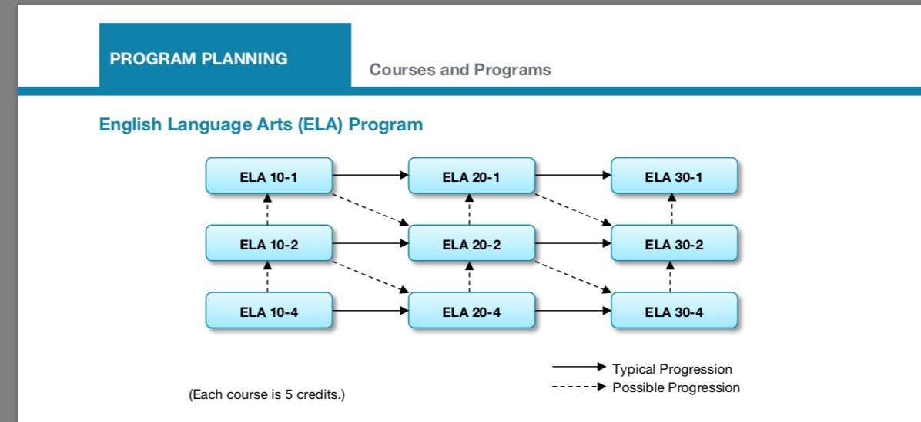

Slide 15
General Information
Course Load Policy
When selecting courses, students need to note the following:
Grade 10 Students are expected to fill a full course load
(8 Courses x 5 Credits = 40 Credits)
Grade 11 Students are expected to register for a minimum of 35 credits of on campus courses (Allowed one (1) “spare”)
Grade 12 Students are expected to register for a minimum of 30 credits of on-campus courses (Allowed two (2) “spares”)
There may be good reasons for not taking a full course load at ICSS and therefore exceptions may be granted upon application to the Principal or Vice-Principal for approval

Slide 16
Academic Goals for Grade 10
Earn 42 credits!
4 courses each semester (no spares)
PE 10 and CALM 20
Complete HCS 3000
No decision you make is final or fatal to your life/career/academic goals

Slide 17
Personal Goals for Grade 10
Self-reflection – noticing if you avoid, procrastinate, do better with support, can you ask for help when needed
Learning support/wellness – CORE Time
Everyone’s path to a diploma is different!
Ownership over your progress towards a diploma
Acknowledging your successes, growth, challenges

Slide 18
Options/Elective Courses
Grade 9 - CTF (No credits awarded)
Grade 10-12 – CTS (credits awarded)
Module-Based (1 credit/per module)
Students will typically gain 3-5 credits per Elective/Option section
Electives/Options Offered (Courses may be blended with Grade 9-12 students together)
Woodshop
Mechanics (dependent on instructor availability)
Music – Band and Choir
Foods and Fashions
Digital Communications
Art
Outdoor Education

Slide 19
Off-Campus Education
Work Experience (Grades 10-12)
Students can work and earn credits (How sweet is that?!)
Can earn a maximum of 30 credits total at the 15/25/35 level (15 Diploma Max)
Must complete HCS 3000 prior to accumulating hours
RAP (Grade 10 and 15 years old)
Work with a journeyman to gain first year apprenticeship hours
Can earn up to 40 high school credits
Green Certificate (Grades 10-12)
Gain hands-on training on a farm, ranch or greenhouse
Allows Grade 10-12 students to earn up to 16 high school credits
Must Complete AG 3000 prior to commencing certificate work

Slide 20
Athletics
ICSS Athletics Policy can be found on our school website
Sports Offered: Golf, Cross-Country, Volleyball, Basketball, Badminton, Track & Field

Slide 21
“The primary goal of Christian education is the formation of a peculiar people – a people who desire the kingdom of God and thus undertake their life’s expression of that desire.” (James K.A. Smith, Desiring the Kingdom)
“It is nothing but a pious wish and a grossly unwarranted hope that students trained to be passive and non-creative in school will suddenly, upon graduation, actively contribute to the formation of Christian culture.” (Nicolas Wolterstorff)
“What if (Christian) education was primarily concerned with shaping our hopes and passions – our visions of the ‘good life’ – and not merely about the dissemination of data and information as inputs to our thinking? What if the primary work of (Christian) education was the transforming of our imagination rather than the saturation of our intellect?” (James K.A. Smith, Desiring the Kingdom)

Slide 22
Keeping Informed

Slide 23
How do I register for my Grade 10 Year?
Thursday, May 12 – Teacher/Student Advisory
Get PowerSchool login from advisor if you don’t have it
Video to show how to register on the website/advisor team
Work with your advisor to pick courses for grade 10
Consider your choices carefully; speak with your teachers about recommendations for Grade 10 and with family about what is best
Online course selection on PowerSchool
Closes Thursday, May 19
If you have difficulties, please contact your teacher advisor first

Slide 24
Questions?

